Slide 1


numerical Methods
Notes:
Note: After adding your pictures, right click on it and “Send To Back”.

Slide 2

Nonlinear equations

Slide 3

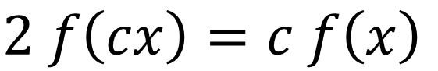
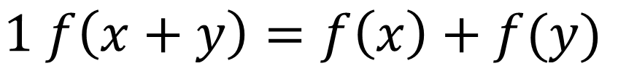
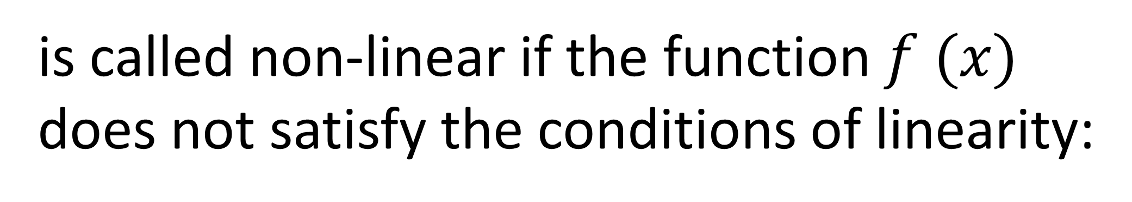

What is a nonlinear equation? ∀
Equation in the form:
$$f\left(x\right)=0$$
is called non-linear if the function $f (x)$
does not satisfy the conditions of linearity:
$$1 f\left(x+y\right)=f\left(x\right)+f(y)$$
$$2 f\left(cx\right)=c f\left(x\right)$$

Slide 4
Approximate solution of linear equations.
Not every equation can be solved exactly. It is not possible to provide universal methods for solving equations of degrees higher than 4th.
An exact solution is not always desirable, especially when the equation coefficients are approximate.
Methods for solving nonlinear equations involve sequential correction of the roots of the function. Most of them can only be used if we know the range in which the elements are found, the so-called element isolation range.
Notes:
Ma to duże znaczenie praktyczne bo….
Nie da się rozwiązać równania dokładniej, niż dane są współczynniki równania.

Slide 5
Example?
Example: The function $f\left(x\right)=x^{2}$does not meet the conditions:
$$2 f\left(cx\right)={\left(cx\right)}^{2}=c^{2}x^{2}≠cx^{2}$$
$$1 f\left(x+y\right)={\left(x+y\right)}^{2}=x^{2}+2xy+y^{2}≠x^{2}+y^{2}$$

Slide 6
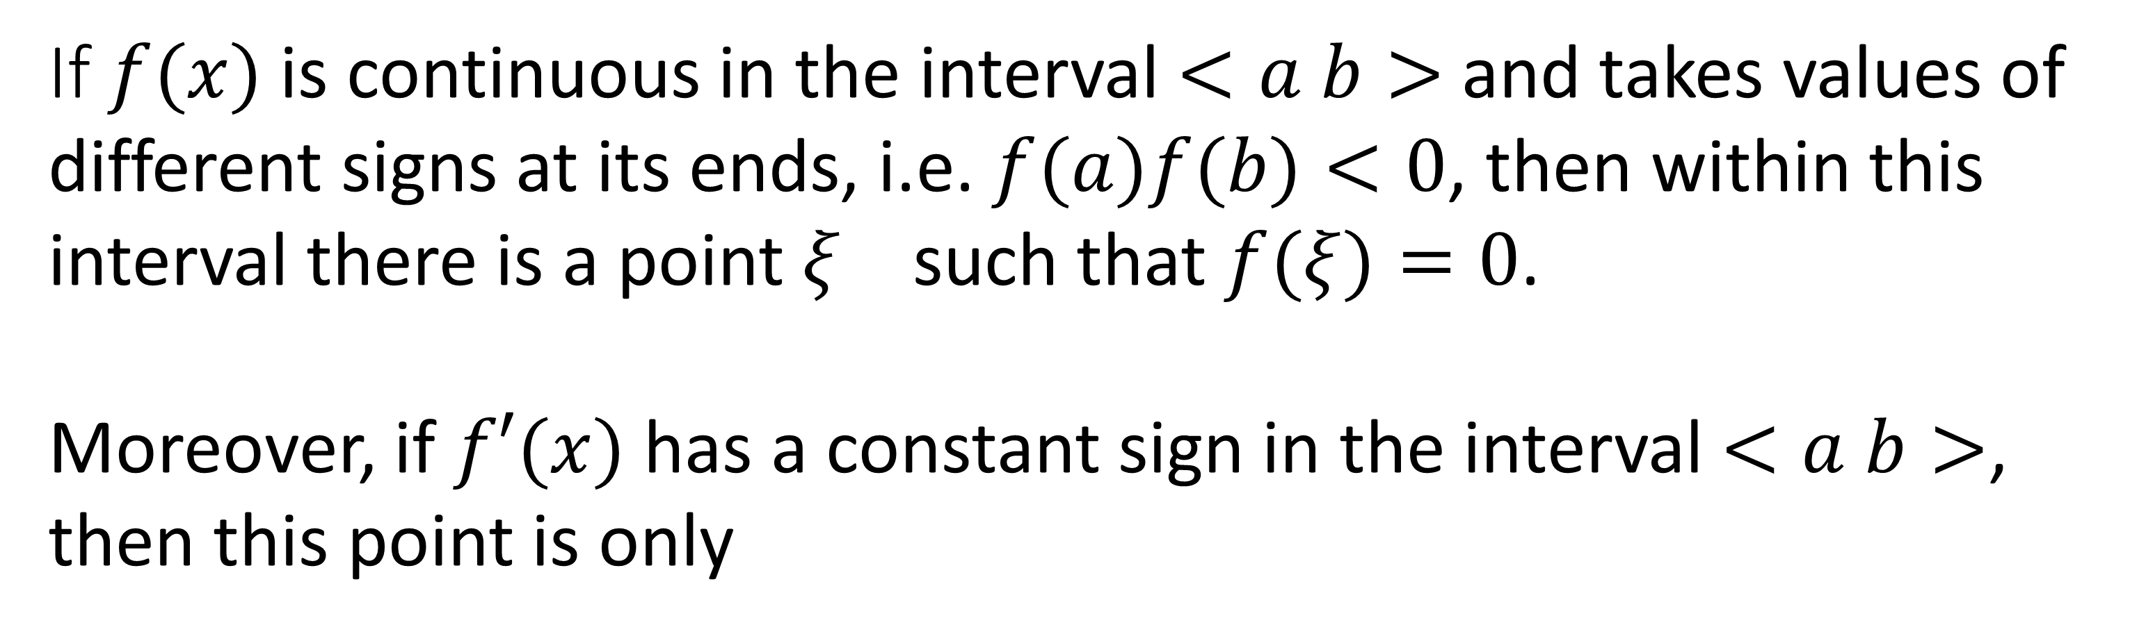
Approximate solution of linear equations.
Most of these methods are based on Bolzano Couchi's theorem:
If $f(x)$is continuous in the interval $<a b>$and takes values of different signs at its ends, i.e. $f(a)f(b)<0$, then within this interval there is a point $ξ$ such that $f(ξ)=0$.
Moreover, if $f′(x)$ has a constant sign in the interval $<a b>$, then this point is only
Notes:
Ma to duże znaczenie praktyczne bo….
Nie da się rozwiązać równania dokładniej, niż dane są współczynniki równania.

Slide 7
Approximate solution of linear equations.
Notes:
Jakiś przykład tego twierdzenia

Slide 8
Approximate solution of linear equations.
Notes:
Jakiś przykład tego twierdzenia

Slide 9
Approximate solution of linear equations.
Notes:
Jakiś przykład tego twierdzenia

Slide 10
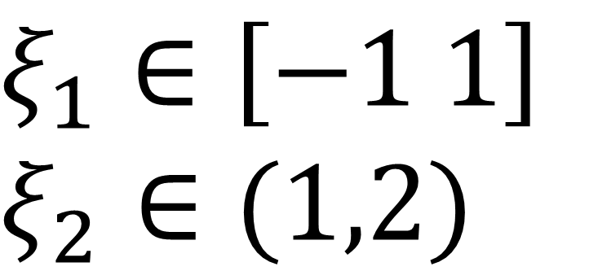

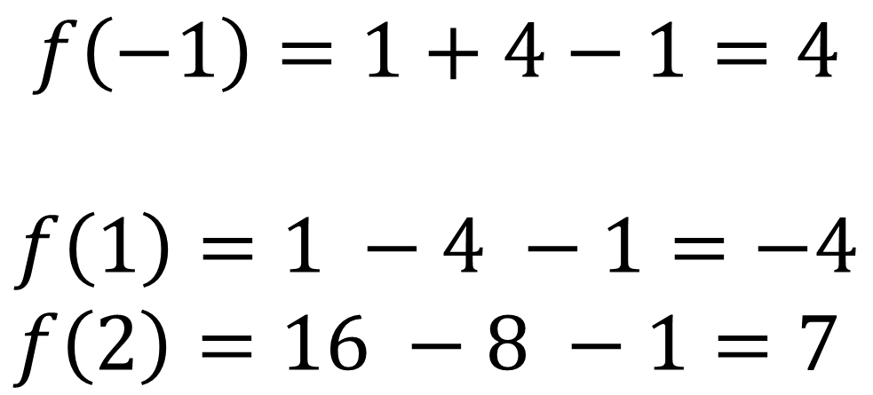
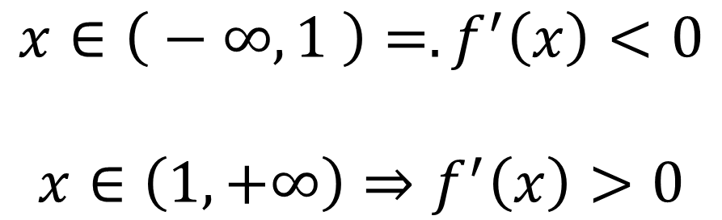
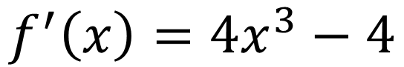
Example
The function $f\left(x\right)=x^{4}−4x−1 f\left(x\right)=0$
$$f^{′}\left(x\right)=4x^{3}−4$$
The sign of the derivative changes at the point x=1, but there is no root at this point.
$$x∈\left( − ∞,1 \right)=. f^{′}\left(x\right)<0$$
$$x∈\left(1, +∞\right)⇒f^{′}\left(x\right)>0$$
It is worth examining the value of the functions to the left and right of this point, e.g.:
$$f\left(−1\right)=1+4−1=4$$
$$f\left(1\right)=1 −4 −1=−4$$
$$f\left(2\right)=16 −8 −1=7$$
$$⇒$$
$$ξ_{1}∈\left[−1 1\right]$$
$$ξ_{2}∈(1,2)$$
Notes:
Na początek warto zbadać wartość pochodnej funkcji….
Potem pogadać o przedziałach….

Slide 11
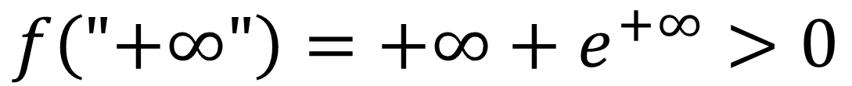


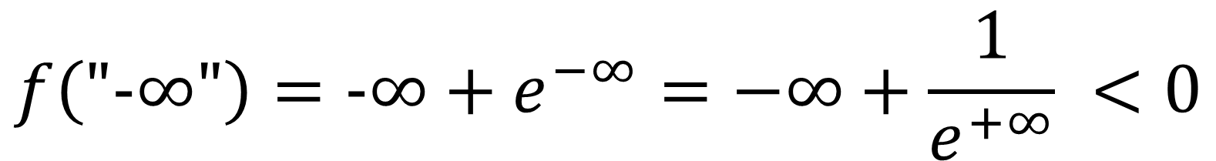
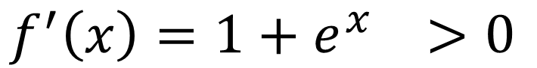
Example
The function $f\left(x\right)=x+e^{x} f\left(x\right)=0$
$$f^{′}\left(x\right)=1+e^{x} >0$$
Increasing, continuous function
$$f\left("\text{−}\text{∞}"\right)=\text{−∞}+e^{−∞}=−∞+\frac{1}{e^{+∞}} <0$$
Only one root
$$⇒$$
$$f\left("\text{+}\text{∞}"\right)=\text{+∞}+e^{+∞}>0$$
The isolation interval of an element, e.g.:
$$<−10 10>$$
Notes:
Na początek warto zbadać wartość pochodnej funkcji….
Potem pogadać o przedziałach….

Slide 12

Generally, it is difficult to find a clear relationship for the zeros (roots) of a nonlinear function.
The complexity of the solution increases with the degree of the polynomial in the equation $f(x) = 0$
Numerical solutions seek to approximate the roots of the equation in an iterative ways.

Slide 13
Iterative algoritms will be work if:
It finds the exact value ,$x_{i}=x_{0}$, its mean $f\left(x_{i}\right)=0$
It obtains a value that meets the accepted error, $f\left(x_{i}\right)≤eps$
It reaches the assumed precision, $\left|x_{i}−x_{i−1}\right|≤eps;$,
It performs the maximum number of iterations.

Slide 14
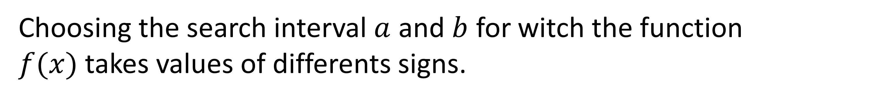

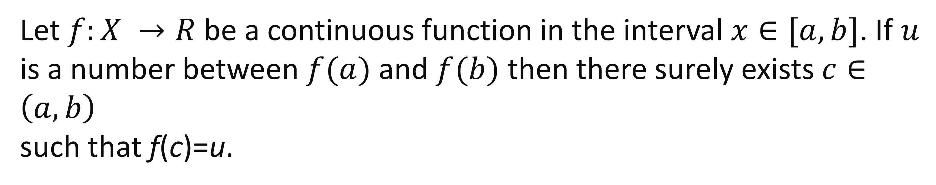
General assumptions for the numerical solving of nonlinear equations:
Choosing the search interval $a$ and $b$ for witch the function $f(x)$takes values of differents signs.
If $f(a) f(b) <0$then for sure ${\text{∃}x}_{0}∈ [a,b]$
Let$f:X →R$be a continuous function in the interval $x∈[a,b]$. If $u$ is a number between $f(a)$ and $f(b)$ then there surely exists $c∈\left(a,b\right)$ such that f(c)=u.
Additionally, if the function is monotonic in the interval$[a,b],$there exists only one such $c$.

Slide 15
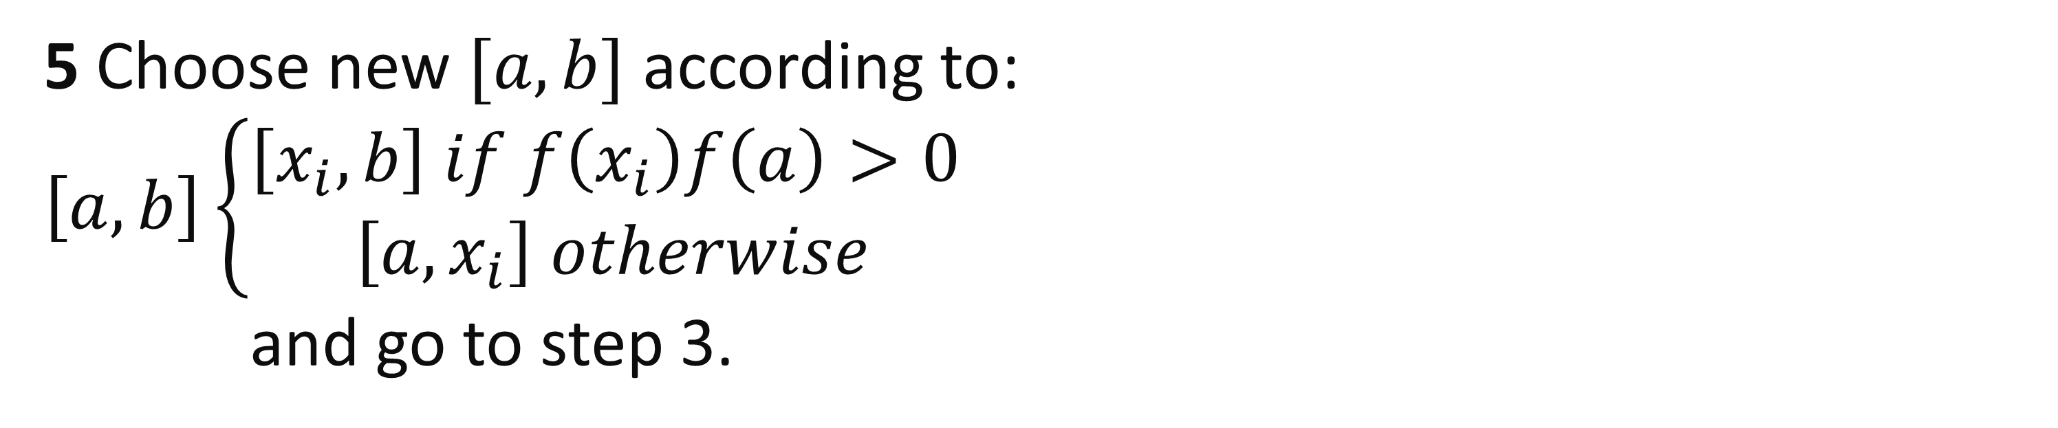
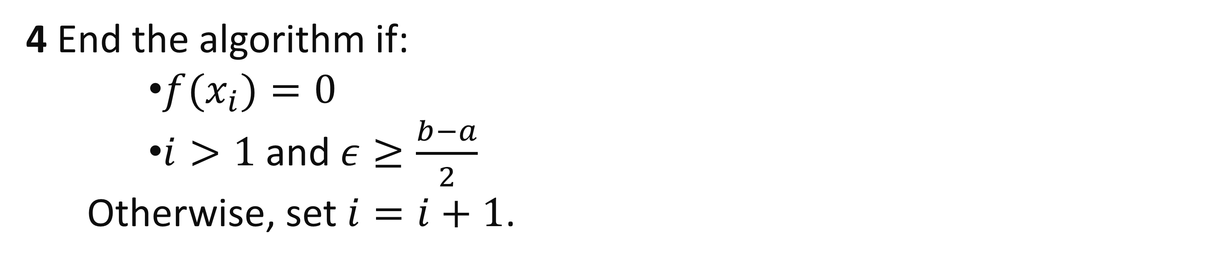
Bissection method - algorithm
1 Set$i=1$and choose $ε$ as the assumed precision condition.
2 Select $a$ and $b$ for which $f(a)⋅f(b)<0$.
3 Calculate the midpoint between $[a,b],$that is $x_{i}=\frac{a+b}{2}$​.
4 End the algorithm if:
$f(x_{i})=0$
$i>1$ and $ε≥\frac{b−a}{2}$
Otherwise, set $i=i+1$.
5 Choose new $[a,b]$ according to:
$\left[a, b\right]\left\{\begin{aligned}\left[x_{i},b\right] if f\left(x_{i}\right)f\left(a\right)>0 \\ \left[a, x_{i}\right] otherwise\end{aligned}\right.$
and go to step 3.

Slide 16
Bissection method - algorithm
If we want to determine the square root with accuracy $:ε$
$$\frac{\left(b−a\right)}{2^{i}}≤ ε$$

Slide 17

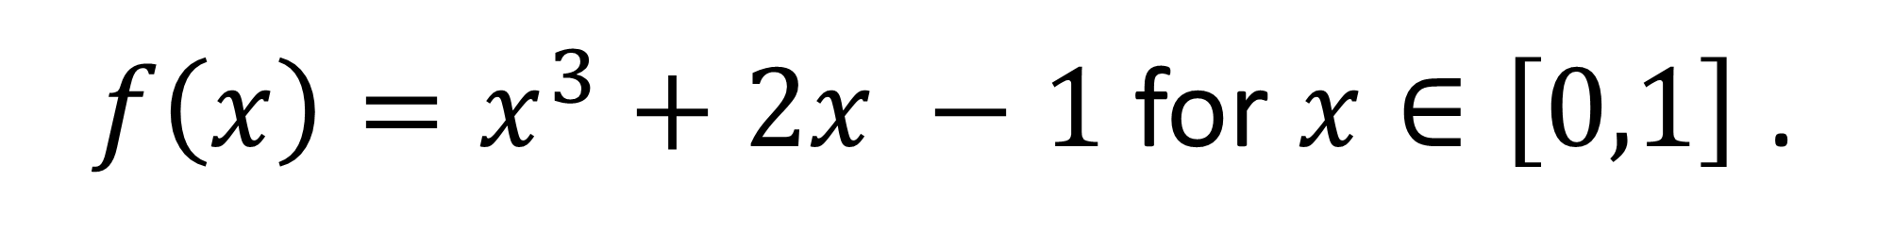
Example
Find the root of the equation in the form:
$f\left(x\right)=x^{3}+2x −1$ for $x∈\left[0,1\right]$ .
Assume that the precision level ($ε$) is :
$$ε=0.1$$

Slide 18

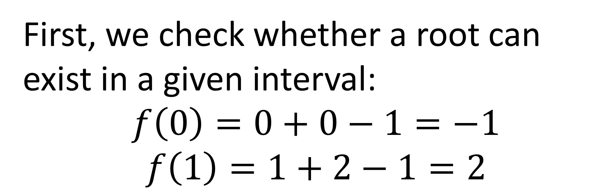


$$f\left(x\right)=x^{3}+2x −1$$
First, we check whether a root can exist in a given interval:
$$f\left(0\right)=0+0−1=−1$$
$$f\left(1\right)=1+2−1=2$$
$$x∈<0 1>$$
$$ε=0.1$$
$$⇒$$
Root exist in this interval
$$f^{′\left(x\right)}={3x}^{2}+2$$
$$f′\left(0\right)=2$$
$$f′\left(1\right)=5$$
$$⇒$$
That increases in a given interval
In given interval exist only one root ( $f(x)=0$)

Slide 19
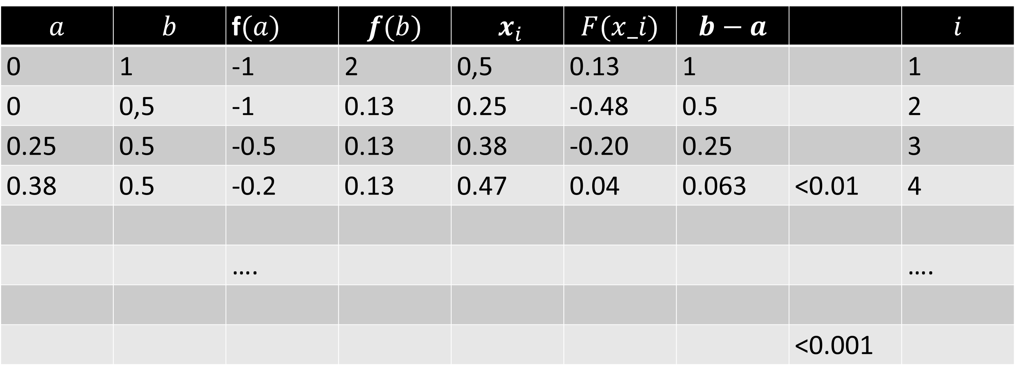
$$f\left(x\right)=x^{3}+2x −1$$
$$x∈<0 1>$$
$$ε=0.1$$
$$a$$ | $$b$$ | f$(a)$ | $$f(b)$$ | $$x_{i}$$ | $$F(x_i)$$ | $$b−a$$ |  | $$i$$
0 | 1 | -1 | 2 | 0,5 | 0.13 | 1 |  | 1
0 | 0,5 | -1 | 0.13 | 0.25 | -0.48 | 0.5 |  | 2
0.25 | 0.5 | -0.5 | 0.13 | 0.38 | -0.20 | 0.25 |  | 3
0.38 | 0.5 | -0.2 | 0.13 | 0.47 | 0.04 | 0.063 | <0.01 | 4
 |  | …. |  |  |  |  |  | ….
 |  |  |  |  |  |  | <0.001

Slide 20
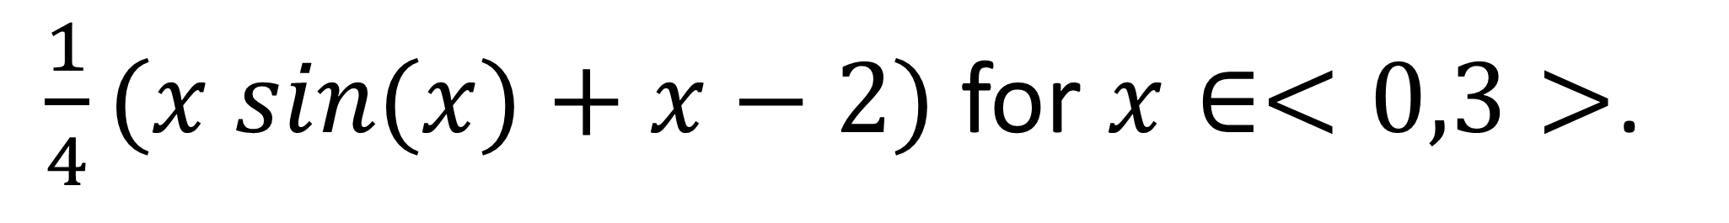
Example
Find the root of the equation in the form:
$\frac{1}{4}(x sin(x)+x−2)$ for $x∈<0,3>$.
Assume that the precision level ($ε$) is :
$$ε=0.00005$$

Slide 21
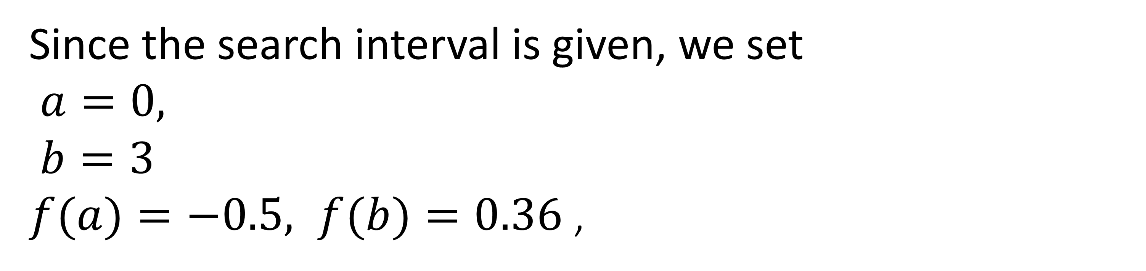
$\frac{1}{4}(x sin(x)+x−2)$ for $x∈[0,3]$ $ε$= $5∗{10}^{−5}$
Since the search interval is given, we set
$a=0,$
$b=3$
$f(a)=−0.5, f(b)=0.36$ ,

Slide 22
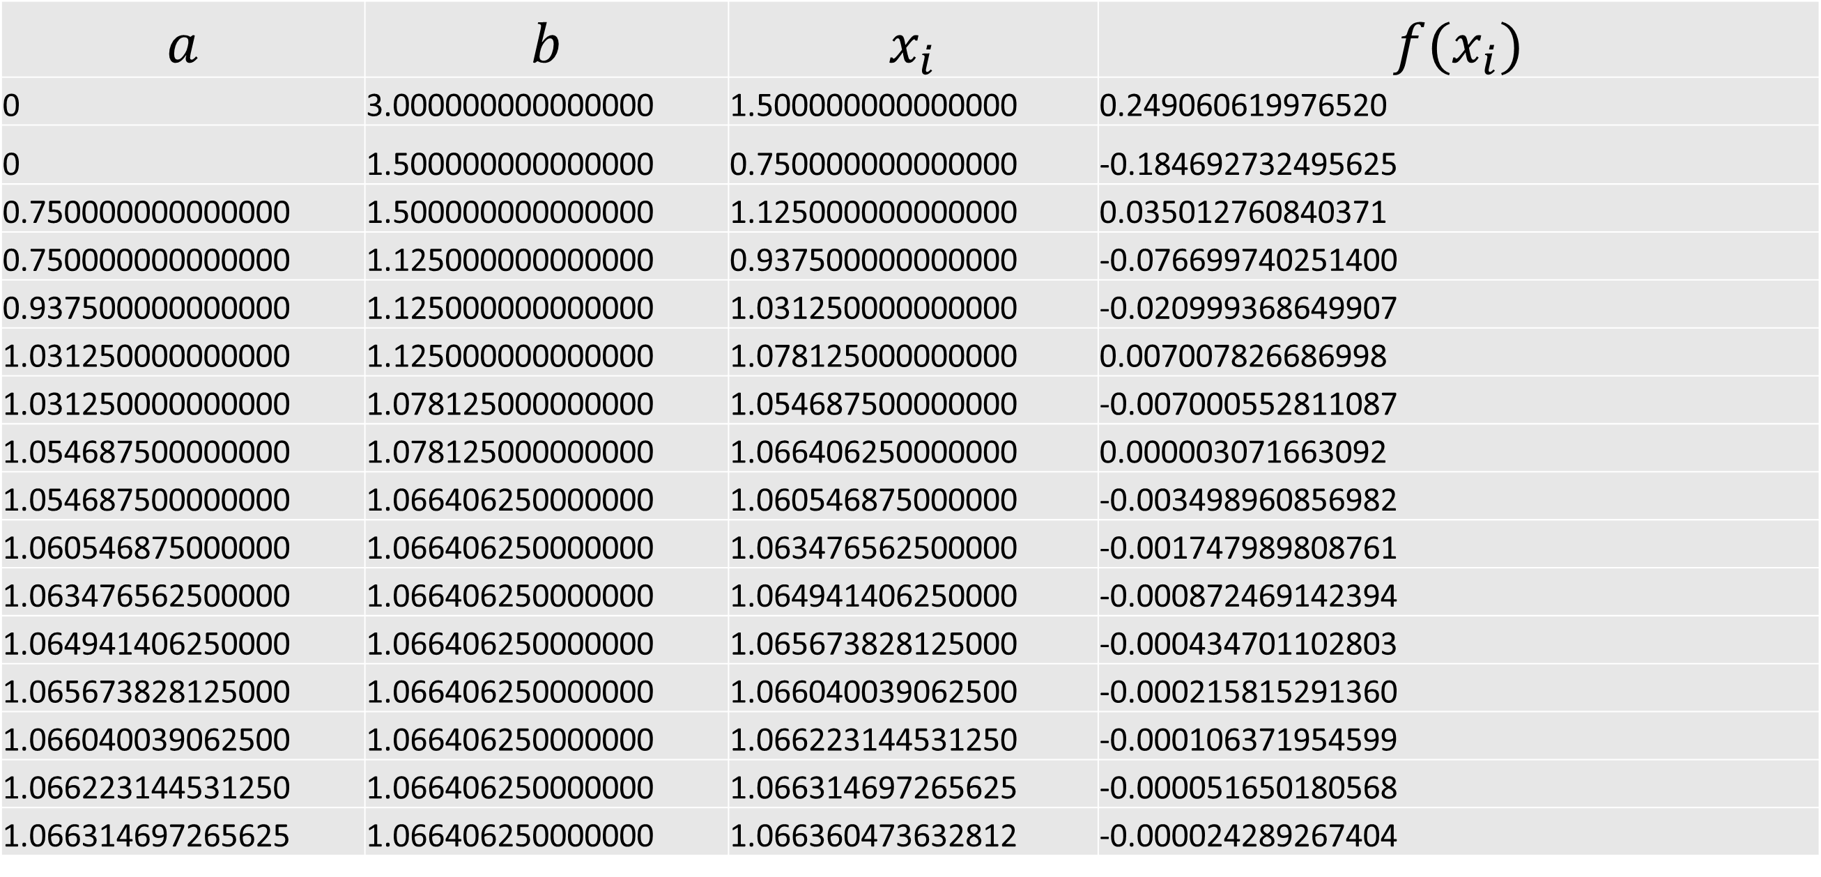
$\frac{1}{4}(xsin(x)+x−2)$ for $x∈[0,3]$. $ε$= $5∗{10}^{−5}$
$$a$$ | $$b$$ | $$x_{i}$$ | $$f(x_{i})$$
0 | 3.000000000000000 | 1.500000000000000 | 0.249060619976520
0 | 1.500000000000000 | 0.750000000000000 | -0.184692732495625
0.750000000000000 | 1.500000000000000 | 1.125000000000000 | 0.035012760840371
0.750000000000000 | 1.125000000000000 | 0.937500000000000 | -0.076699740251400
0.937500000000000 | 1.125000000000000 | 1.031250000000000 | -0.020999368649907
1.031250000000000 | 1.125000000000000 | 1.078125000000000 | 0.007007826686998
1.031250000000000 | 1.078125000000000 | 1.054687500000000 | -0.007000552811087
1.054687500000000 | 1.078125000000000 | 1.066406250000000 | 0.000003071663092
1.054687500000000 | 1.066406250000000 | 1.060546875000000 | -0.003498960856982
1.060546875000000 | 1.066406250000000 | 1.063476562500000 | -0.001747989808761
1.063476562500000 | 1.066406250000000 | 1.064941406250000 | -0.000872469142394
1.064941406250000 | 1.066406250000000 | 1.065673828125000 | -0.000434701102803
1.065673828125000 | 1.066406250000000 | 1.066040039062500 | -0.000215815291360
1.066040039062500 | 1.066406250000000 | 1.066223144531250 | -0.000106371954599
1.066223144531250 | 1.066406250000000 | 1.066314697265625 | -0.000051650180568
1.066314697265625 | 1.066406250000000 | 1.066360473632812 | -0.000024289267404

Slide 38


Bissection method
If the initial condition is correct, the bisection method always converges to $x_{0}$​.
If $x_{0}$ ​ is an irrational number, an exact solution will not be achieved.
If $x_{0}$​ is a number with many significant digits, the calculations will take too long.
The bisection method converges only linearly (slowly).
It is worth using, for example, for preliminary approximation of the search interval value as an initialization for more efficient methods.

Slide 39
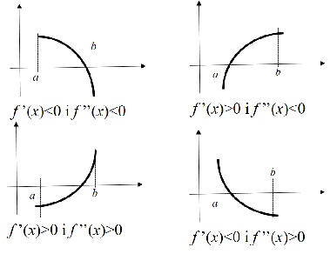

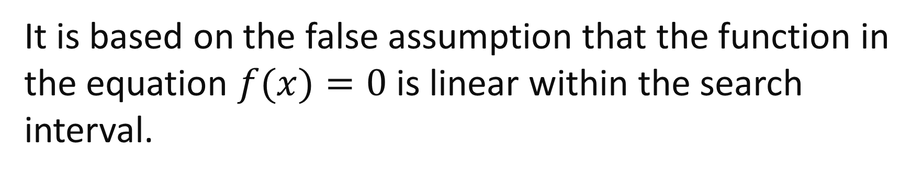


False position method
It is based on the false assumption that the function in the equation $f(x)=0$is linear within the search interval.
An additional assumption is that $f′(x)$and $f′′(x)$have a constant sign in interval $<a b>$
This false assumption allows for finding $x_{}$​ faster than the bisection method.
Since it's linear, finding the root of a linear function, for which we know $a$, $b$, and $f(a)$, $f(b)$, directly follows from the formula for the zero of a linear function:

Slide 40
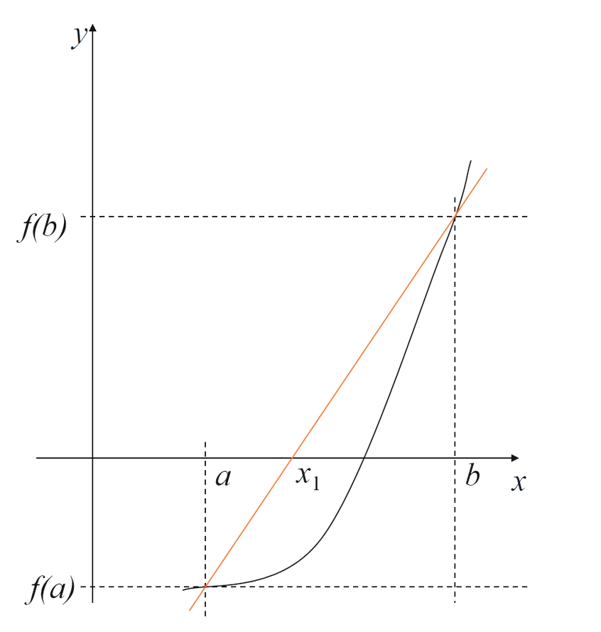
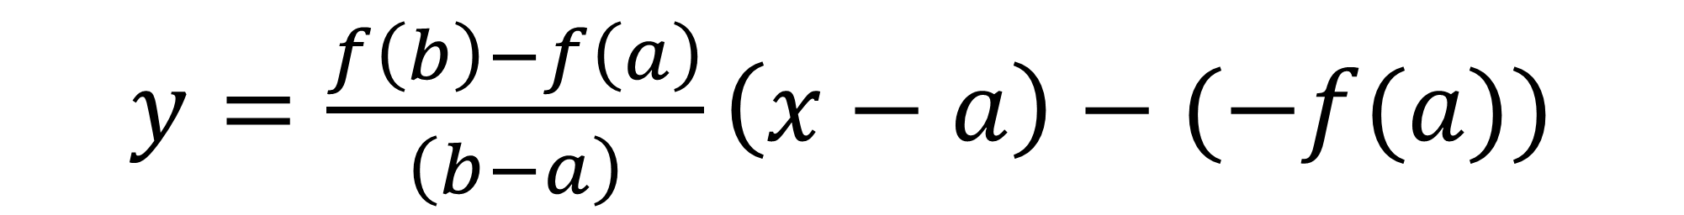

False position method
Let us consider one of the cases, the remaining formulas are derived analogously.
$$\operatorname{tg}\left(α\right)=\frac{f\left(b\right)−f\left(a\right)}{b−a}$$
$y=\frac{f\left(b\right)−f\left(a\right)}{\left(b−a\right)}\left(x−a\right)−(−f(a))$
Notes:
Zakładamy sałszywie pozytywnie że funkcja jest w przedziale liniowa (czerwona linia i pierwsza i druga pochodna mają stały znak)
Bazując na prostych obliczeniach możemy sobie obliczyć że pierwiastek może być w x1
Ale funkcja nie jest liniowa
Pokazać jakie są odległości….
No i teraz z trójkąta pitagorasa możemy sobie policzyć tg(alfa)
Ale możemy to zrobić odrobinę inaczej….
Przesunąć kreskę czerwoną do góry ……
Więc pierwsze przybliżenie pierwiastka tam gdzie wartość prostej jest zero….

Slide 41
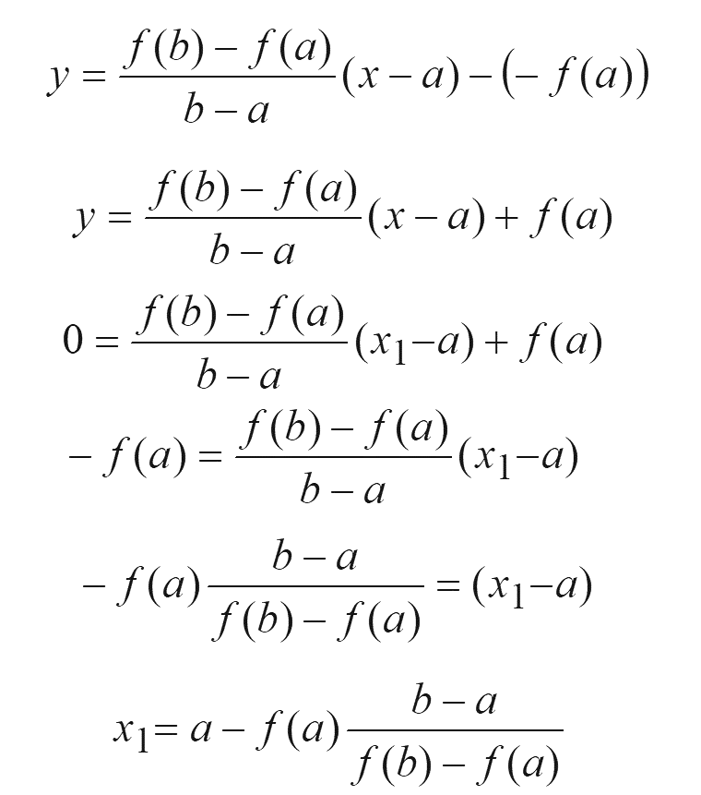
Notes:
Zakładamy wałfywie że funkcja jest w przedziale liniowa
Próbujemy rozwiązać te równanie
I wyliczamy x1, czyli nasz nowy pierwiastek…..

Slide 42
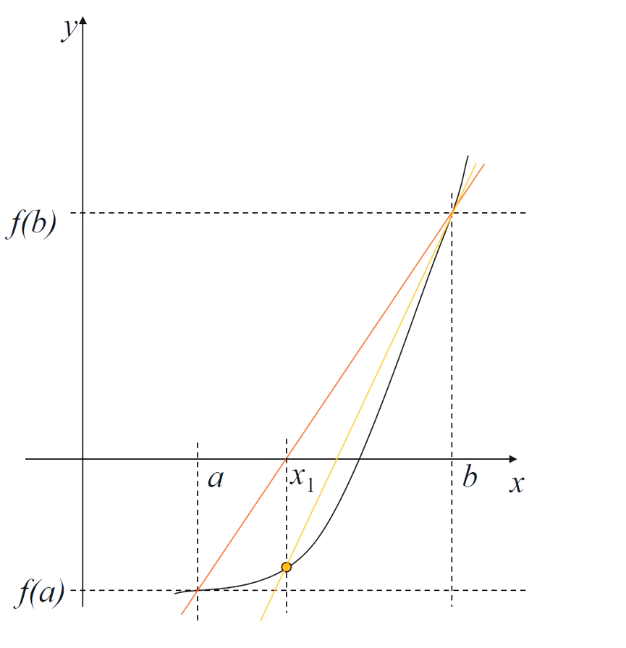
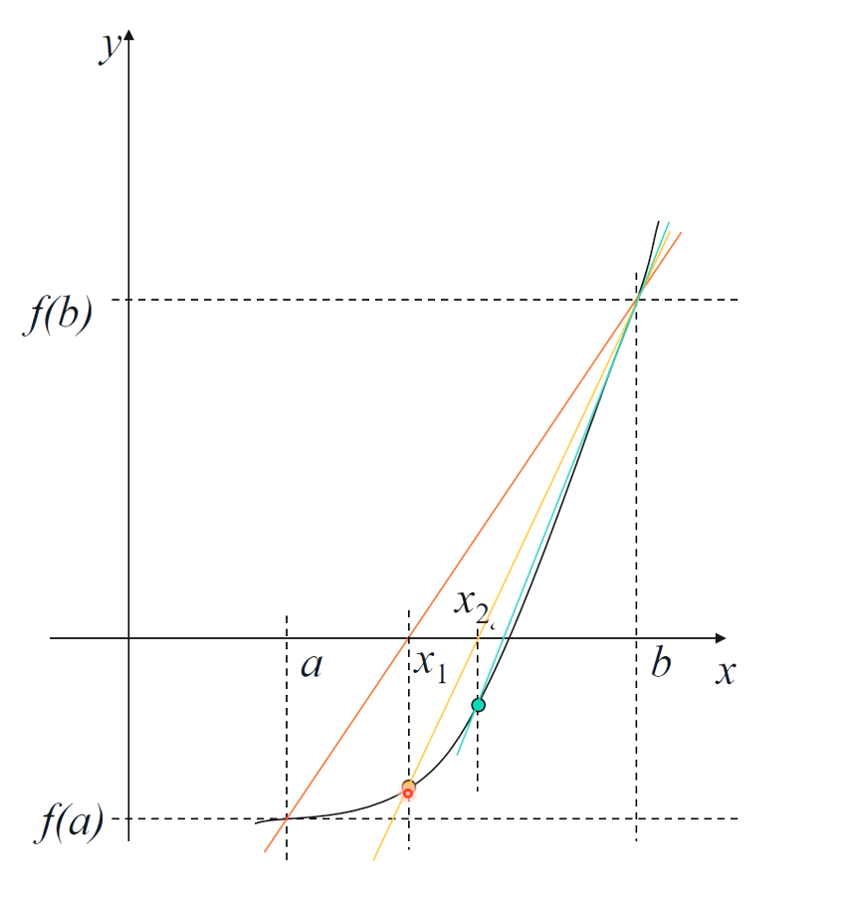
Notes:
Liczymy kolejną cięciwę…….
Zauważmy tutaj, że zmienia się tutaj kolejna cięciwa….
W tej metodzie zmienia się nasz punkt b……

Slide 43
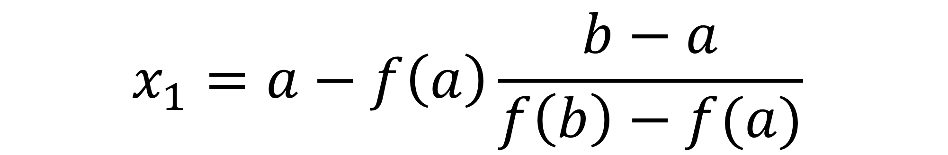
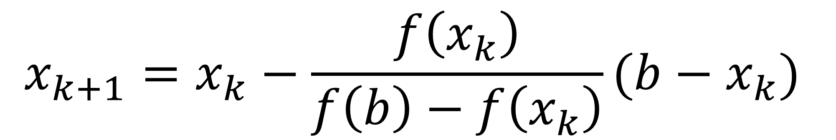
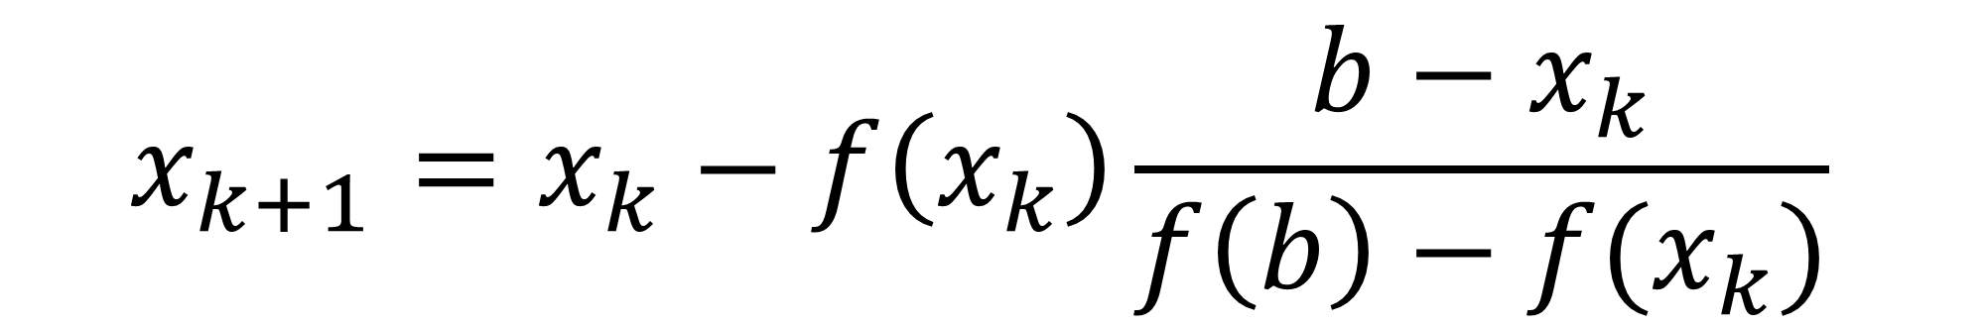
$$x_{1}=a−f\left(a\right)\frac{b−a}{f\left(b\right)−f(a)}$$
$$x_{k+1}=x_{k}−f\left(x_{k}\right)\frac{b−x_{k}}{f\left(b\right)−f(x_{k})}$$
$$x_{k+1}=x_{k}−\frac{f\left(x_{k}\right)}{f\left(b\right)−f\left(x_{k}\right)}(b−x_{k})$$
Notes:
Równanie możemy modyfikować do następującej postaci:

Slide 44
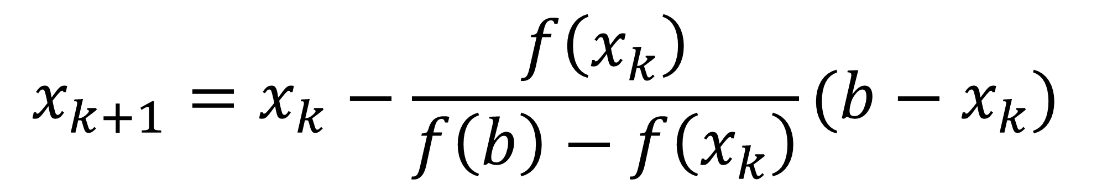
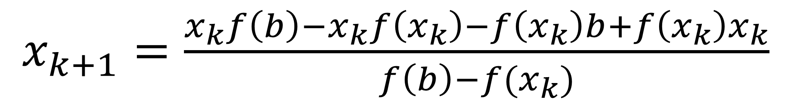
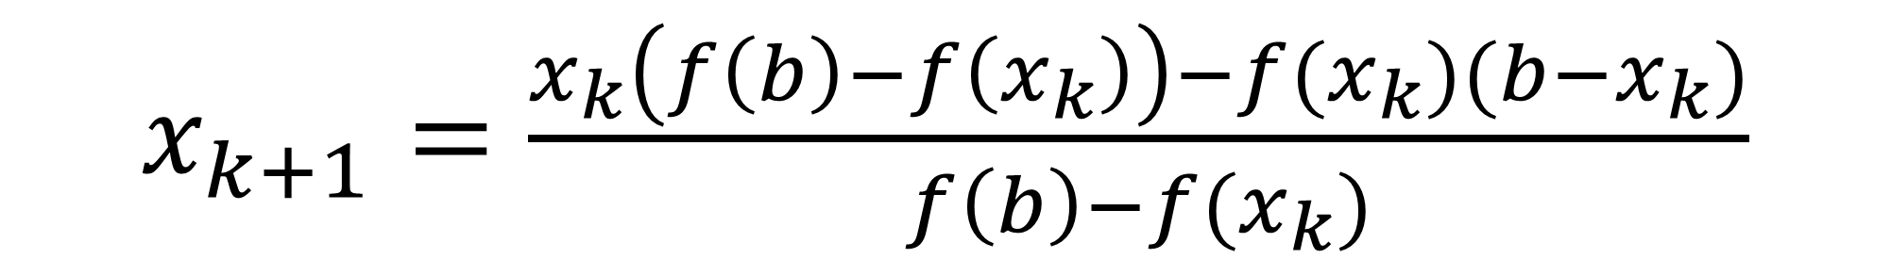
$$x_{k+1}=x_{k}−\frac{f\left(x_{k}\right)}{f\left(b\right)−f\left(x_{k}\right)}(b−x_{k})$$
$x_{k+1}=\frac{x_{k}\left(f\left(b\right)−f\left(x_{k}\right)\right)−f(x_{k})(b−x_{k})}{f\left(b\right)−f(x_{k})}$
$x_{k+1}=\frac{x_{k}f\left(b\right)−x_{k}f\left(x_{k}\right)−f\left(x_{k}\right)b+f\left(x_{k}\right)x_{k}}{f\left(b\right)−f(x_{k})}$
$x_{k+1}=\frac{x_{k}f\left(b\right)−f\left(x_{k}\right)b }{f\left(b\right)−f(x_{k})}=\frac{x_{k}f\left(c_{const}\right)−f\left(x_{i}\right)c_{const}}{f\left(c_{const}\right)−f(x_{k})}$
Notes:
Równanie możemy modyfikować do następującej postaci:

Slide 45

Error estimation
$$f^{′}\left(\overline{x}\right)≅\frac{f\left(x_{k+1}\right)−f\left(ξ\right)}{x_{k+1}−ξ}=\frac{f\left(x_{k+1}\right)−0}{x_{k+1}−ξ}$$
$|x_{k+1 }−ξ |=\frac{\left|f\left(x_{k+1}\right)\right|}{\left|f^{′}\left(\overline{x}\right)\right|}≤\frac{|f(x_{k+1})|}{m}$
$$m= \inf_{a≤x≤b}{|f′(x)|}$$
Notes:
Próbujemy oszacować dokładność pierwiastka jako iloraz różnicwy
Szukamy wartości funkcji w punkcie xi, gdzie powinien być pierwiastek…. Który wynosi ZERO
Punkt x z kreską to jakiś punkt w przedziale….
Więc tutaj znowu szacujemy najbardziej niekorzystny przypadek……..

Slide 46
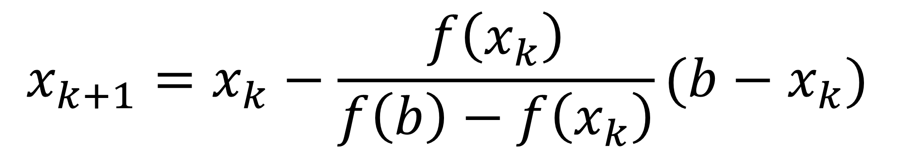


Error estimation
$$x_{k+1}=x_{k}−\frac{f\left(x_{k}\right)}{f\left(b\right)−f\left(x_{k}\right)}(b−x_{k})$$
$${(x}_{k+1}−x_{k})(f\left(b\right)−f\left(x_{k}\right))=−f(x)(b−x_{k})$$
$${(x}_{k+1}−x_{k}) \frac{\left(f\left(b\right)−f\left(x_{k}\right)\right)}{\left(b−x_{k}\right)} =−f(x)$$
$${(x}_{k+1}−x_{k}) \frac{\left(f\left(b\right)−f\left(x_{k}\right)\right)}{\left(b−x_{k}\right)} =f(ξ)−f(x)$$
Notes:
Tutaj wyprowadzamy wzór na przybliżenia…….
Mamy wzór na pierwiastek dla naszego przypadku
I go przekształcamy

Slide 47


Error estimation
$${(x}_{k+1}−x_{k}) \frac{\left(f\left(b\right)−f\left(x_{k}\right)\right)}{\left(b−x_{k}\right)} =f(ξ)−f(x)$$
From Lagrange's increment theorem, part of the expression can be replaced:
$$\frac{f\left(ξ\right)−f(x_{k})}{ξ−x_{k}}=f^{′}\left(ξ_{k}\right), ξ<ξ_{k}<x_{k}⇒f\left(ξ\right)−f\left(x_{k}\right)=f^{′}\left(ξ\right)(ξ−x_{k})$$
$$\frac{\left(f\left(b\right)−f\left(x_{k}\right)\right)}{\left(b−x_{k}\right)} =f^{′}\left({\overline{x}}_{k}\right), x_{k}<{\overline{x}}_{k}<b$$
Notes:
Tutaj wyprowadzamy wzór na przybliżenia…….
Mamy wzór na pierwiastek dla naszego przypadku
I go przekształcamy

Slide 48

Error estimation
$${(x}_{k+1}−x_{k}) \frac{\left(f\left(b\right)−f\left(x_{k}\right)\right)}{\left(b−x_{k}\right)} =f(ξ)−f(x)$$
$$\frac{\left(f\left(b\right)−f\left(x_{k}\right)\right)}{\left(b−x_{k}\right)} =f^{′}\left({\overline{x}}_{k}\right), x_{k}<{\overline{x}}_{k}<b$$
$$\left(x_{k+1}−x_{k}\right)f^{′}\left({\overline{x}}_{k}\right)=f′(ξ_{k})(ξ−x_{k})$$
$\left(x_{k+1}−x_{k}\right)f^{′}\left({\overline{x}}_{k}\right)−x_{k+1}f^{′}\left(ξ_{k}\right)=f^{′}\left(ξ_{k}\right)ξ−f^{′}\left(ξ_{k}\right)x_{k}$ $−x_{k+1}f^{′}\left(ξ_{k}\right)$

Slide 49
Error estimation
$\left(x_{k+1}−x_{k}\right)f^{′}\left({\overline{x}}_{k}\right)−x_{k+1}f^{′}\left(ξ_{k}\right)=f^{′}\left(ξ_{k}\right)ξ−f^{′}\left(ξ_{k}\right)x_{k}$ $−x_{k+1}f^{′}\left(ξ_{k}\right)$
$\left(x_{k+1}−x_{k}\right)f^{′}\left({\overline{x}}_{k}\right)−x_{k+1}f^{′}\left(ξ_{k}\right)=f^{′}\left(ξ_{k}\right)(ξ−x_{k+1})$- $f^{′}\left(ξ_{k}\right)x_{k}$
$\left(x_{k+1}−x_{k}\right)f^{′}\left({\overline{x}}_{k}\right)=f^{′}\left(ξ_{k}\right)(ξ−x_{k+1})$- $f^{′}\left(ξ_{k}\right)x_{k}+x_{k+1}f^{′}\left(ξ_{k}\right)$
$\left(x_{k+1}−x_{k}\right)f^{′}\left({\overline{x}}_{k}\right)=f^{′}\left(ξ_{k}\right)(ξ−x_{k+1})$+$f^{′}\left(ξ_{k}\right){(x}_{k+1}−x_{k})$
$$\left(x_{k+1}−x_{k}\right)f^{′}\left({\overline{x}}_{k}\right)−f^{′}\left(ξ_{k}\right){(x}_{k+1}−x_{k})=f^{′}\left(ξ_{k}\right)(ξ−x_{k+1})$$
$$f^{′}\left(ξ_{k}\right)\left(ξ−x_{k+1}\right)=(x_{k+1}−x_{k})(f^{′}\left({\overline{x}}_{k}\right)−f^{′}\left(ξ\right))$$
$$\left(ξ−x_{k+1}\right)=\frac{\left(x_{k+1}−x_{k}\right)\left(f^{′}\left({\overline{x}}_{k}\right)−f^{′}\left(ξ\right)\right)}{f^{′}\left(ξ_{k}\right)}$$
Notes:
Omawiamy bardzo dużo przekształceń żeby pokazać ile wynosi błąd…..
Mówimy że szacowanie to pochodnadwóch ostatnich przybliżeń i pokazuje co szacujemy………

Slide 50

$$\left(ξ−x_{k+1}\right)=\frac{\left(x_{k+1}−x_{k}\right)\left(f^{′}\left({\overline{x}}_{k}\right)−f^{′}\left(ξ\right)\right)}{f^{′}\left(ξ_{k}\right)}$$
$$|ξ−x_{k+1} |≤\left|x_{k+1}−x_{k}\right|\frac{\left(M−m\right)}{m}$$
$$M=\sup_{a≤x≤b}{|f′(x)|}$$
$$M≤2m⇒\left|ξ−x_{k+1}\right|≤\left|x_{k+1}−x_{k}\right|\frac{2m−m}{m}=|x_{k+1}x_{k}|$$
$$\left|ξ−x_{k+1}\right|≤|x_{k+1}−x_{k}|$$
Notes:
Tutaj przy szacowaniu musimy przyjąć minimalną wartość pochodnej i
Dla licznika musimy przyjąć najbardziej niekorzystną sytuację, wartość maks i minimalną co do modułu
A w mianowniku minimalną co do modułu…….

Slide 51
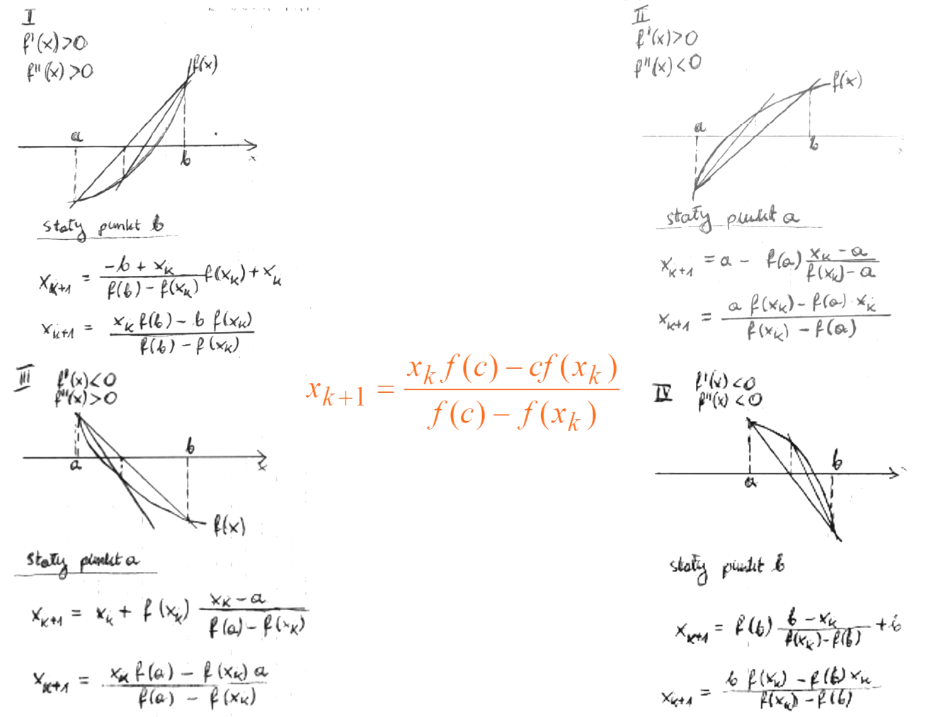
Notes:
Tutaj przy szacowaniu musimy przyjąć minimalną wartość pochodnej i
Dla licznika musimy przyjąć najbardziej niekorzystną sytuację, wartość maks i minimalną co do modułu
A w mianowniku minimalną co do modułu…….

Slide 52

False position method
It is based on the false assumption that the function in the equation $f(x)=0$is linear within the search interval.
This false assumption allows for finding $x0$​ faster than the bisection method.
Since it's linear, finding the root of a linear function, for which we know $a$, $b$, and $f(a)$, $f(b)$, directly follows from the formula for the zero of a linear function:
$$ex_{0}​=\frac{af\left(b\right)−bf\left(a\right)}{f\left(b\right)−f\left(a\right)}$$
Naturally, $​\tilde{x}≠x_{0}$​ but $f( \tilde{x_{0})}>0$ or $f(​{\tilde{x}}_{0})<0$.

Slide 53

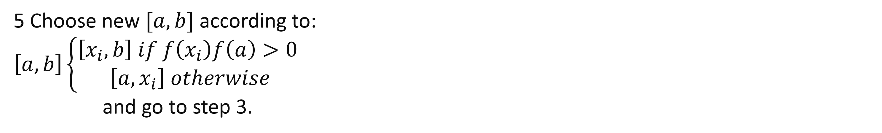
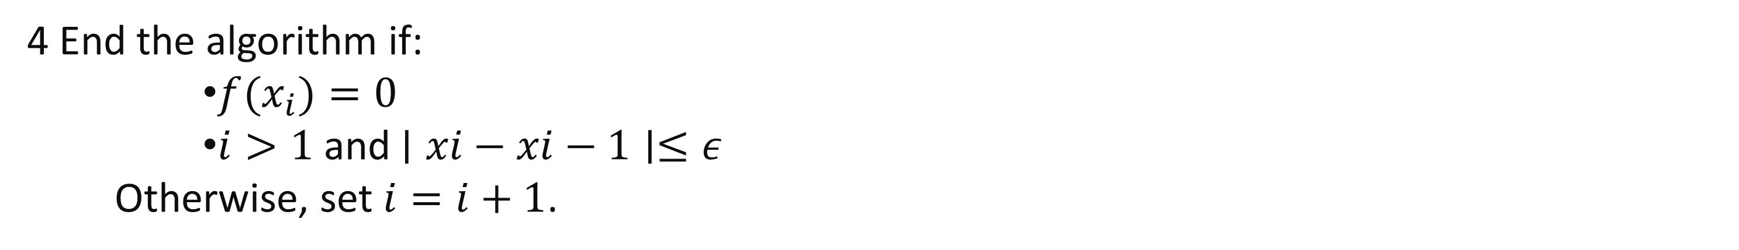
False position method - algorithm
1 Set$i=1$and choose ϵ as the assumed precision condition.
2 Select $a$ and $b$ for which $f(a)⋅f(b)<0$.
3 Calculate the zero assuming the function is linear between the points a,f(a)) and (b,f(b)) :
​.
$$x_{i}​=\frac{af\left(b\right)−bf\left(a\right)}{f\left(b\right)−f\left(a\right)}$$
4 End the algorithm if:
$f(x_{i})=0$
$i>1$ and $∣xi−xi−1∣≤ε$
Otherwise, set $i=i+1$.
5 Choose new $[a,b]$ according to:
$\left[a, b\right]\left\{\begin{aligned}\left[x_{i},b\right] if f\left(x_{i}\right)f\left(a\right)>0 \\ \left[a, x_{i}\right] otherwise\end{aligned}\right.$
and go to step 3.

Slide 54
False position method - example
Find the root of the equation in the form :
$\frac{1}{4}(x sin(x)+x−2)$ for $x∈[0,3]$.
Assume that the precision level ($ε$) is :
$5E−05 (0.00005)$.

Slide 55
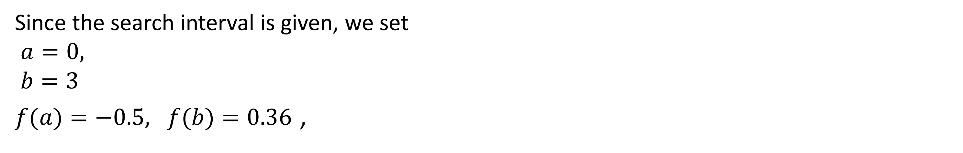
$\frac{1}{4}(x sin(x)+x−2)$ for $x∈[0,3]$ $ε$= $5∗{10}^{−5}$
Since the search interval is given, we set
$a=0,$
$b=3$
$f(a)=−0.5, f(b)=0.36$ ,

Slide 56
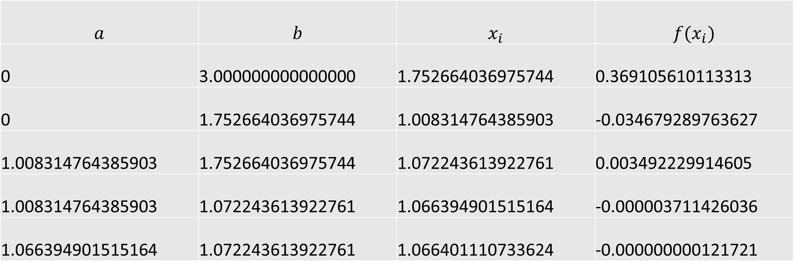
$\frac{1}{4}(x sin(x)+x−2)$ for $x∈[0,3]$ $ε$= $5∗{10}^{−5}$
$$a$$ | $$b$$ | $$x_{i}$$ | $$f(x_{i})$$
0 | 3.000000000000000 | 1.752664036975744 | 0.369105610113313
0 | 1.752664036975744 | 1.008314764385903 | -0.034679289763627
1.008314764385903 | 1.752664036975744 | 1.072243613922761 | 0.003492229914605
1.008314764385903 | 1.072243613922761 | 1.066394901515164 | -0.000003711426036
1.066394901515164 | 1.072243613922761 | 1.066401110733624 | -0.000000000121721

Slide 63
False position method - coments
In the false position method, from a certain iteration, one of the interval boundaries stops changing.
In the secant method, we protect against this by using two previous approximations in each iteration.
Unfortunately, it may diverge or find a root outside the search interval.

Slide 65
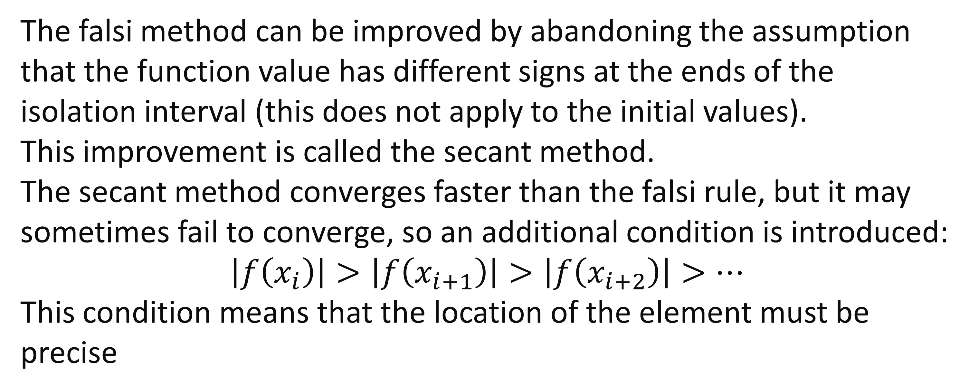
Secand method
The falsi method can be improved by abandoning the assumption that the function value has different signs at the ends of the isolation interval (this does not apply to the initial values).
This improvement is called the secant method.
The secant method converges faster than the falsi rule, but it may sometimes fail to converge, so an additional condition is introduced:
$$\left|f\left(x_{i}\right)\right|>\left|f\left(x_{i+1}\right)\right|>\left|f\left(x_{i+2}\right)\right|>…$$
This condition means that the location of the element must be precise

Slide 66
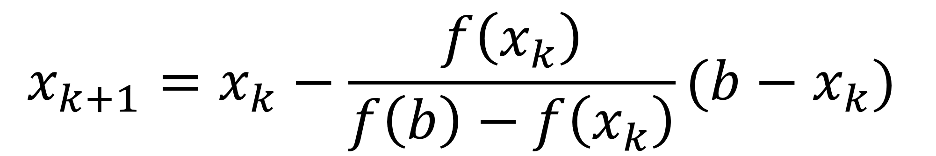


$$x_{k+1}=x_{k}−\frac{f\left(x_{k}\right)}{f\left(b\right)−f\left(x_{k}\right)}(b−x_{k})$$
$$x_{k+1}<−x_{n+1}$$
$$x_{k}<−x_{n}$$
$$b<−x_{n−1}$$
$$x_{n+1}=x_{n}−\frac{f\left(x_{n}\right)}{f{(x}_{n−1})−f\left(x_{n}\right)}(x_{n−1}−x_{n})$$
$$\left|f\left(x_{n−1}\right)\right|>\left|f\left(x_{n}\right)\right|>\left|f\left(x_{n+1}\right)\right|$$
Notes:
Powiedzieć że pod odpowiadające miejsca podstawiamy przybliżenia pierwiastka….
I finalnie otrzymujemy wzór w takim stylu:

Slide 67

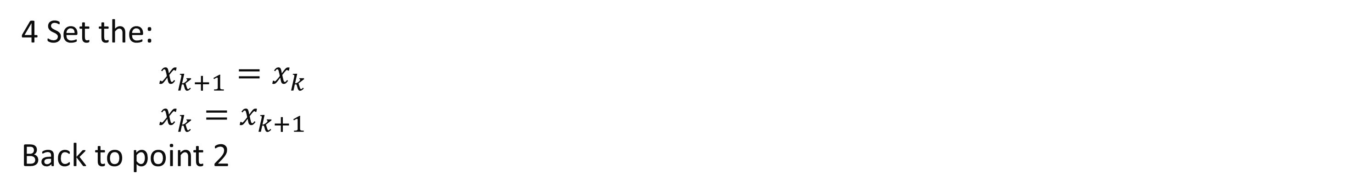
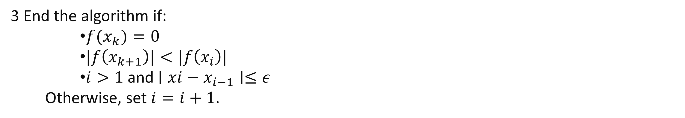
Secand method- algorithm
1 Select $a$ and $b$ for which $f\left(a\right)⋅f\left(b\right)<0,$ set $k=1, x_{0}=a, x_{1}=b$ .
2 Calculate the zero assuming the function is linear between the points a,f(a)) and (b,f(b)) :
​.
$$x_{k+1}​=\frac{x_{k}−x_{k−1}}{f\left(x_{k}\right)−f\left(x_{k−1}\right)}$$
3 End the algorithm if:
$f(x_{k})=0$
$|f\left(x_{k+1}\right)|<|f\left(x_{i}\right)|$
$i>1$ and $∣xi−x_{i−1}∣≤ε$
Otherwise, set $i=i+1$.
4 Set the:
$x_{k+1}=x_{k}$
$x_{k}=x_{k+1}$
Back to point 2

Slide 68
Notes:
Tutaj kończymy na dzisiaj a kontynuacja na następnych zajęciach

Slide 69
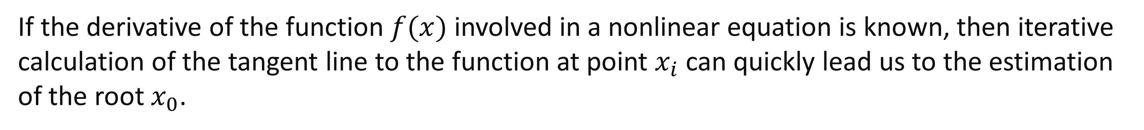
Newton – Raphson method
If the derivative of the function $f(x)$ involved in a nonlinear equation is known, then iterative calculation of the tangent line to the function at point $x_{i}$​ can quickly lead us to the estimation of the root $x_{0}$​.
Obtaining the tangent line to the function $f(x)$ at point $a$ is possible from the first term of the Taylor series expansion of the given function:
$y=f\left(a\right)+\left(x−a\right) \frac{∂x}{∂f} {\left.​\right|}_{x=a^{}}$,
where $\frac{∂x}{∂f}{\left.​\right|}_{x=a}​$ is the value of the partial derivative $\frac{∂x}{∂f}$​ at point $x=a$.

Slide 70
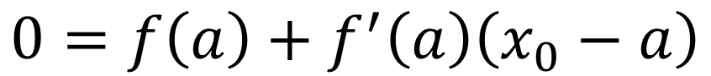
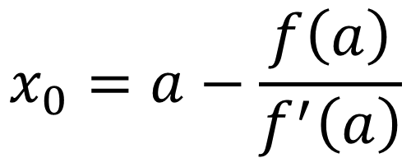
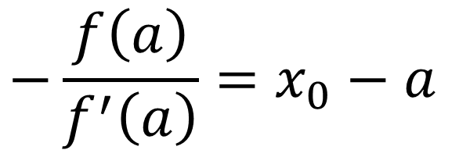
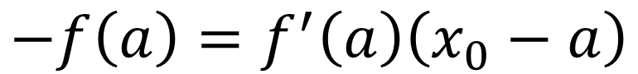
Newton – Raphson method
If $f(x)$ is a function of one variable $(x)$, we can denote $\frac{∂x}{∂f} {\left.​\right|}_{x=a^{}}$ as f$′(a)$ and solve the tangent equation:
$$0=f\left(a\right)+f^{′}\left(a\right)\left(x_{0}−a\right)$$
$$−f\left(a\right)=f^{′}\left(a\right)\left(x_{0}−a\right)$$
$$−\frac{f\left(a\right)}{f^{′}\left(a\right)}=x_{0}−a$$
$$x_{0}=a−\frac{f\left(a\right)}{f^{′}\left(a\right)}$$

Slide 71
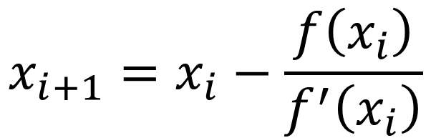
Newton – Raphson method
It is easy to transform the relationship into an iterative formula:
$$x_{i+1}=x_{i}−\frac{f\left(x_{i}\right)}{f^{′}\left(x_{i}\right)}$$

Slide 72


Newton – Raphson - algorithm
1 Set$i=1$and choose ϵ as the assumed precision condition.
2 Select $x_{i}$ as start point:
$$x_{i}\left\{\begin{aligned}a, if f\left(a\right)f^{′′}\left(a\right)>0 \\ &b, othervise\end{aligned}\right.$$
.
5 Calculate $x_{i+1}=x_{i}−\frac{f\left(x_{i}\right)}{f^{′}\left(x_{i}\right)}$
End the algorithm if:
$f(x_{i})=0$
$i>1$ and $∣xi−xi−1∣≤ε$
Otherwise, set $i=i+1$.
3 Calculate the midpoint between $[a,b],$that is $x_{i}=\frac{a+b}{2}$​.

Slide 73
Newton – Raphson method - example
Let's consider the problem of approximating the square root of two.
$$x$$
To solve it, one needs to prepare the appropriate nonlinear equation:
$$x=\sqrt{2}$$
$$x^{2}=2$$
$$x^{2}−2=0$$

Slide 74

$$x^{2}−2=0$$
$$x_{i}$$ | $$f\left(x_{i}\right)$$
3.000000000000000 | 7.000000000000000
1.833333333333333 | 1.361111111111111
1.462121212121212 | 0.137798438934803
1.414998429894803 | 0.002220556604757
1.414213780047198 | 0.000000615675384
1.414213562373112 | 0.000000000000048
1.414213562373095 | -4.44089209850063e-16

Slide 75
Newton – Raphson - coments
Let's consider the problem of approximating the square root of two.
$$x$$
To solve it, one needs to prepare the appropriate nonlinear equation:
$$x=\sqrt{2}$$
$$x^{2}=2$$
$$x^{2}−2=0$$

